Slide 1
Book Keeping and Accounting Software for IMO’s

Slide 2
ABSTRACT
To develop a software which produces book-keeping and accounting aid to the imo’s . The software will also ENABle the imo’s to pay various statutory dues and taxes on time with zero errors. The imo’s are ngo’s which get loans from the rashtriya mahila kosh (rmk). The loans acquired by the imo’s are further lent to women entrepreneurs in rural and urban India. These women are a part of shg’s (self help groups) or joint lender groups (jlg’s). the software developed according to current accounting standards and imo’s will be able to view the overall financial position. This will help imo’s to make profitable decisions and it will also enlighten the imo’s on the subject of income generating activities and loss making activities

Slide 3
Overview
RASHTRIYA MAHILA KOSH
INTERMEDIATE ORGANIZATIONS
(IMO’s)
SELF HELP GROUPS
(SHG)

Slide 4
RASHTRIYA MAHILA KOSH
LOAN RECEIVED BY NGO FROM RASHTRIYA MAHILA KOSH
INTEREST PAID BY NGO TO RASHTRIYA MAHILA KOSH
CALCULATING INTEREST AND STORING DATA INTO DATABASE
VIEWING THE TRANSACTION DETAILS
REPAYING INTEREST
VIEWING THE TRANSACTION DETAILS

Slide 5
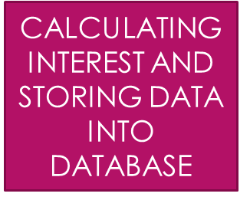

SELF HELP GROUPS (SHG)
LOAN GIVEN TO SELF HELP GROUPS BY NGO’S
INTEREST PAID BY SELF HELP GROUPS TO NGO’S
REGISTERING SELF HELP GROUPS TO NGO’S
REPAYING INTEREST
VIEWING THE TRANSACTION DETAILS

Slide 6
PROFIT AND LOSS
INTEREST RECEIVED
(FROM SHG)
INTEREST PAID
(TO RMK)
PROFIT/LOSS = INTEREST RECEIVED – INTEREST PAID

